Slide 1
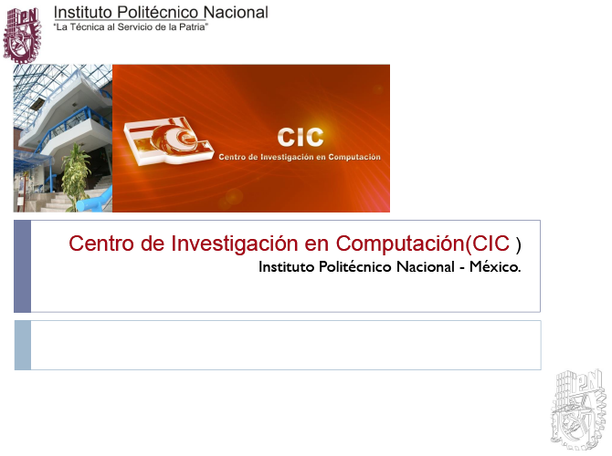

Laboratorio de Ciberseguridad
Paper Title
Author paper:
Presenter:
Course: Mobile Security A-15
Instructor: Dr. Ponciano Jorge Escamilla Ambrosio

Slide 2
Contribution
Explain in your own words the contribution of the paper.

Slide 3
Concept and Methodology
Explain in your own words the prevailing concept(s) of the authors and the methodology they applied to achieve their goal.

Slide 4
Results
Explain in your own words the results (simulation, prototype, field deployment, review, etc.) obtained as a result of applying the concept and the methodology.

Slide 5
Comparison
Refer to one more related approach and provide a comparative work. Using a table may be helpful.

